Slide 2
Paul Barnhurst
MBA specializing in Finance
Master of Science in Information Management
13 years of FP&A experience
Digicert
Solera
American Express
Various companies as a consultant
Host of FP&A Today podcast
LinkedIn content creator
Trainer (Excel, FP&A, Data Visualization)
The FP&A Guy
Website: TheFPandAGuy.COM
LinkedIn: Paul Barnhurst | LinkedIn
Email: Pbarnhurst@thefpandaguy.com

Slide 3
My FP&A Tools Story
Started with an Excel Website
Wrote about FP&A vendors to get a job with a few
Vendors started contacting me for Demos
Opportunity to write 3rd Gen Market Guide presented itself
Have talked to over 100 software vendors and done demos of 60+ FP&A Tools

Slide 4
Agenda
A brief history of spreadsheets
Brief history of FP&A tools (1st ,2nd ,3rd Gen)
Strengths & weakness of each
Current market landscape
Method for comparing tools
4 Core pillars of FP&A tools
Market predictions going forward

Slide 5
Spreadsheet Timelines
Launch of VisiCalc Spreadsheet (1979)
Launch of Excel 2.0 for Windows (1987)
Launch of Numbers running on iPad (2010)
Launch of Equals Cloud Spreadsheet (2021)
1980
1990
2000
2010
2020
Launch of Lotus 1-2-3 (1983)
Launch of Excel 365 (2011)
Launch of Google Sheets (2006)

Slide 6
SPREADSHEETS
Notes:
Introduction to Microsoft Excel 1990 - YouTube

Slide 7
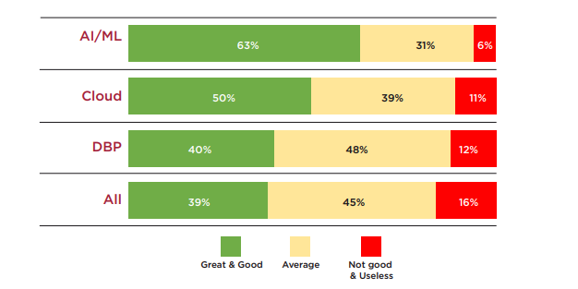
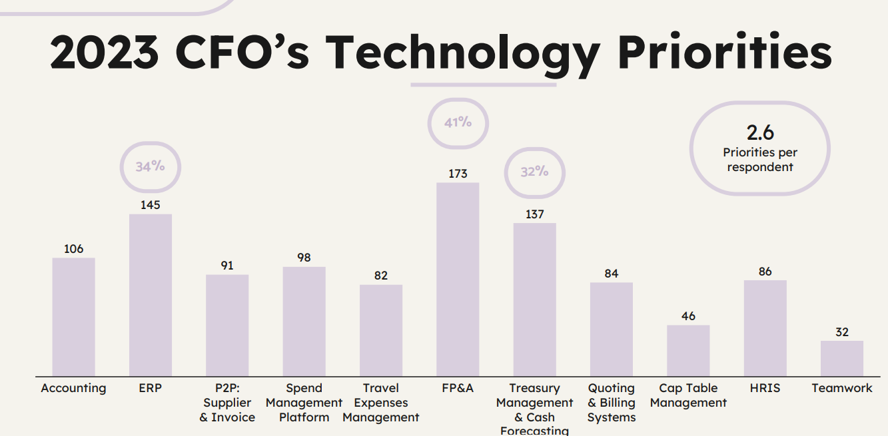
FP&A Surveys
2022 FP&A Trends Survey Forecast Accuracy
The CFO Stack Technology Survey (2022/2023)
FP&A Trends Survey 2022: How Technology Advances FP&A to the Tole of Strategic Advisor | FP&A Trends (fpa-trends.com)
Survey conducted by Charles Tenot in late 2022, early 2023 using CFO Connect

Slide 8
1st Generation FP&A Software
Heavy-weight on prem solutions
Long implementation time (6 months or more)
Heavy hardware costs making them affordable by only large enterprises
Often required custom coding
Often required dedicated staff to support

Slide 9
2ND Generation FP&A Software
Cloud based
Reduced implementation time compared to Gen 1
Lower cost compared to Gen 1
Focused primarily on midmarket and above
Products still predominantly used by FP&A

Slide 10
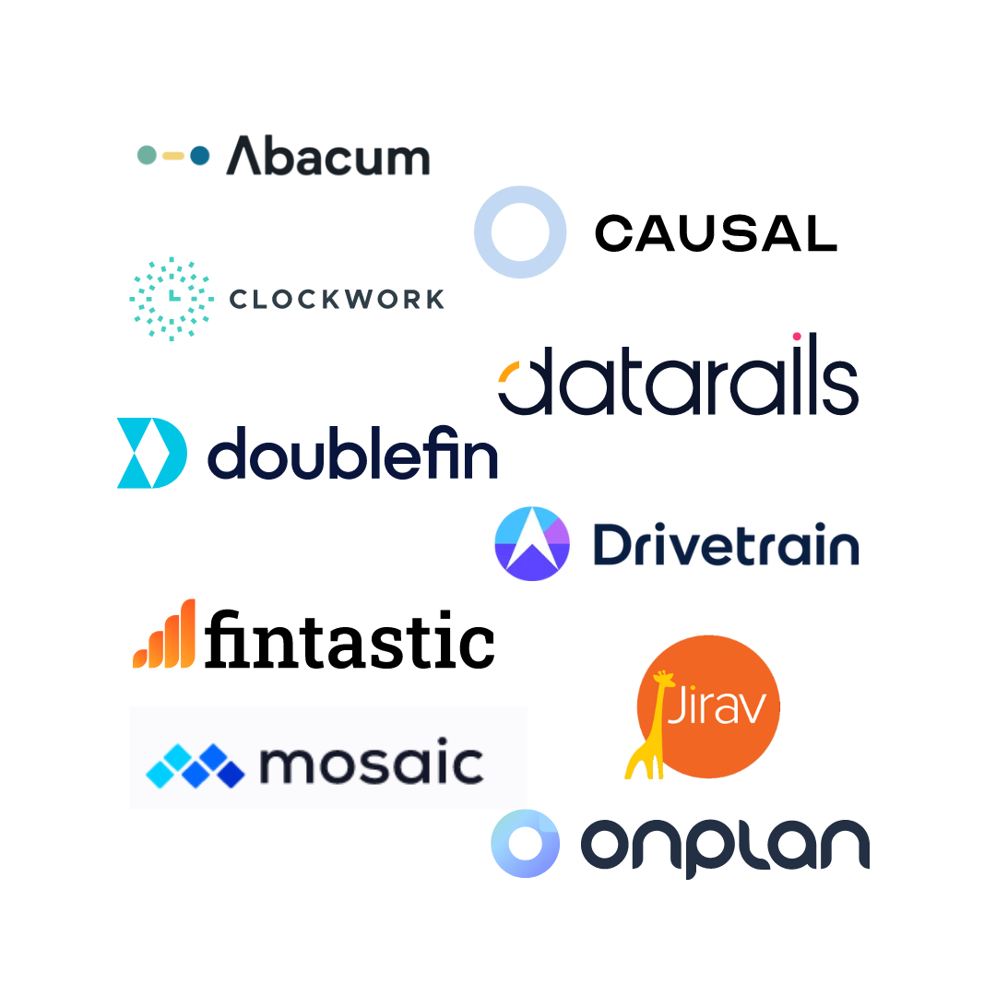
3RD Generation FP&A Software
Software delivered as a service
User centric-design
Focused primarily on small to mid-market
Usually, shorter implementation time
Lower cost
More self-service features

Slide 11
Spreadsheets VS. FP&A Tools
Spreadsheets
Agility
Low cost
Minimal training required
Lack of version control
Lack of data integration
Lack of security controls
FP&A Tools
Data integration
Automated reporting
Security & version control
Consolidation
Scalability
Less flexibility
Training required
Cost

Slide 12
FP&A Software Market Explosion (2015-2022)

Slide 13
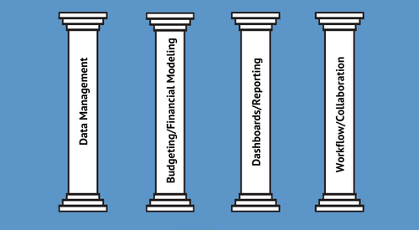
4 Core Pillars of FP&A Tools

Slide 14
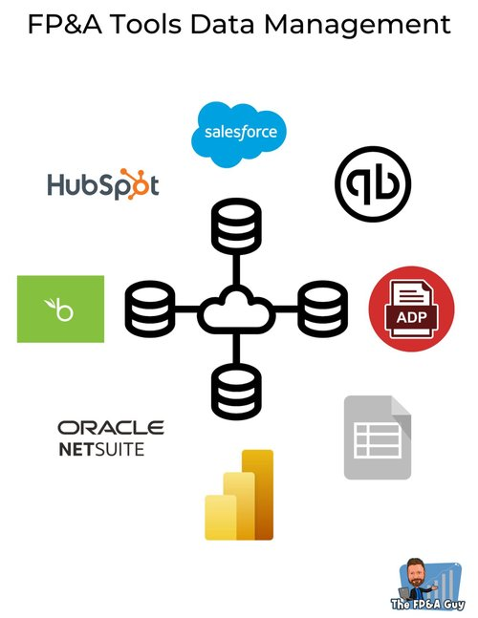
Data Management
What to think about:
Data integrations (ERP, CRM, HRIS, Billing, etc.)
How does it store your data?
Can you create your own custom metrics
How many dimensions and attributes can you have
How does it manage security and privacy rights

Slide 15
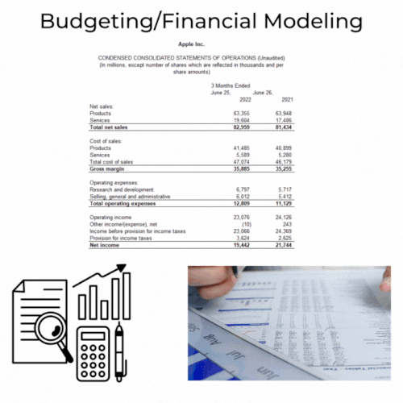
Financial Modeling
What to think about:
What does it use for a calculation engine (Spreadsheet, Multi-dimensional model, other?)
Can it easily perform scenario and sensitivity modeling?
Can it support all your different types of modeling (Revenue, Expense, Headcount, Supply Chain, etc.)

Slide 16
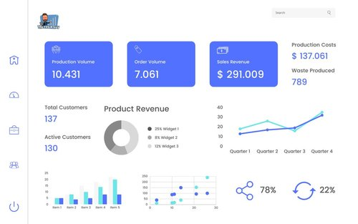
Dashboard/Reporting
What to think about:
Can you build custom reports
Does it do any anomaly detections of your data
Can you comment on a line and report level
Does it integrate with PPT, Slides, etc
What is the lisc. approach for report view access

Slide 17
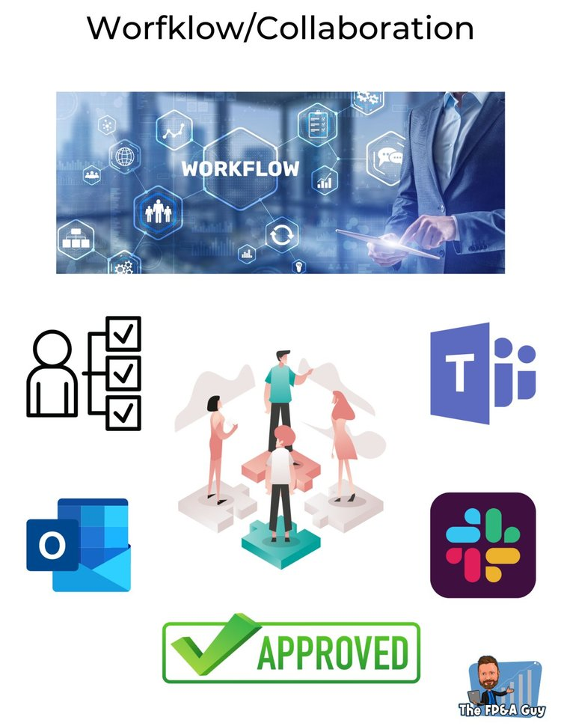
Workflow/Collaboration
What to think about:
Does it support workflows, can you build your own custom workflows
How many levels of approval can you have
What notification options are available
Does it integrate with Teams, Slack, etc.

Slide 18
Segmenting the market

Slide 19
Segmenting the market
Company Size (X – Axis)
Small - (<500 Employees)
Medium - (500-5,000 Employees)
Large/Enterprise – 5,000+
Note: This is an estimate, one can also use headcount, and it is important to note that every vendor on the map has a range, so they will go above and below the point placed, but it is more to give you a general idea of where each company sits.

Slide 20
Segmenting the market
Tool Type on the Y- Axis (6 Categories)
Spreadsheet Add-In (Liveflow, Genius Sheets)
Spreadsheet Native (Datarails, Vena, Cube)
Web App – High Spreadsheet Integration (TM1, Jedox)
Web App – Medium Spreadsheet Integration (Abacum, Prophix, Planful)
Web App – Low Spreadsheet Integration (Clockwork, Mosaic)
Web App – Spreadsheet Replacement (Causal, Arithmix)

Slide 21
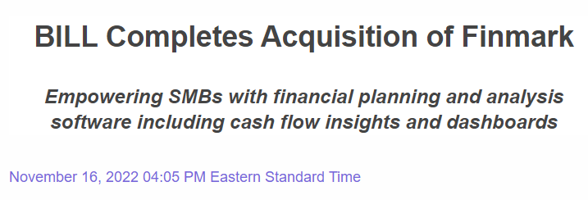
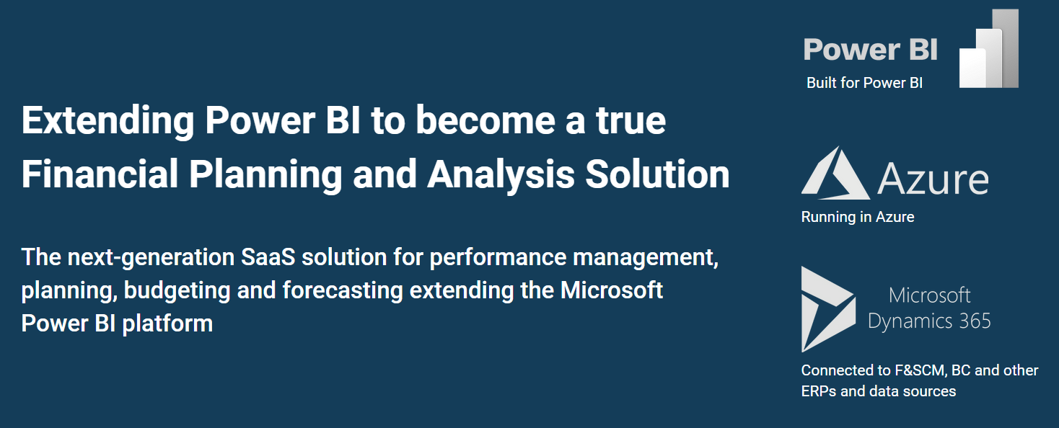
Market Predictions
Product-Led Growth
Spreadsheet Tools
Integrated BI Planning
Ben Murray Annual SAAS Tech Stack Survey (FP&A Tools)
Year 1: 11% Planning Tool
Year 2: 21% Planning Tool
Year 3: 23% Planning Tool
Year 4: 27% Planning Tool
Market Consolidation
Increased SMB Adoption
Greater AI Adoption

Slide 22
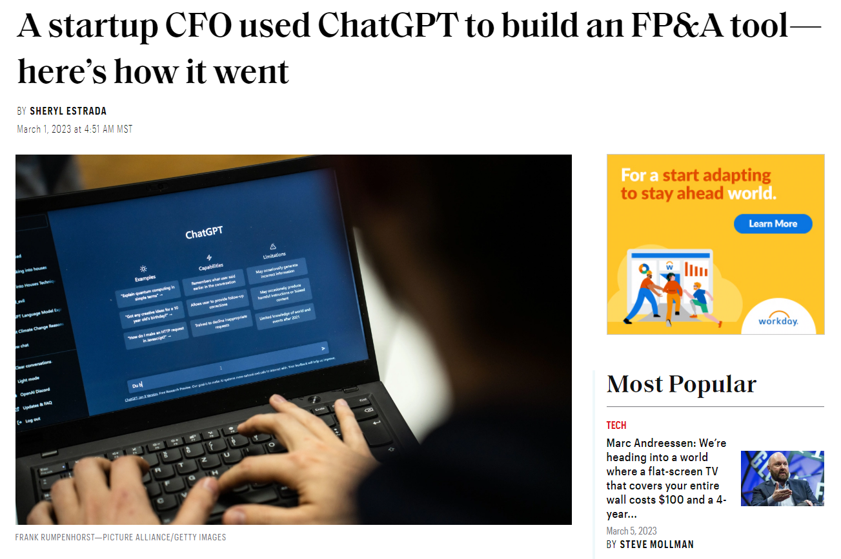
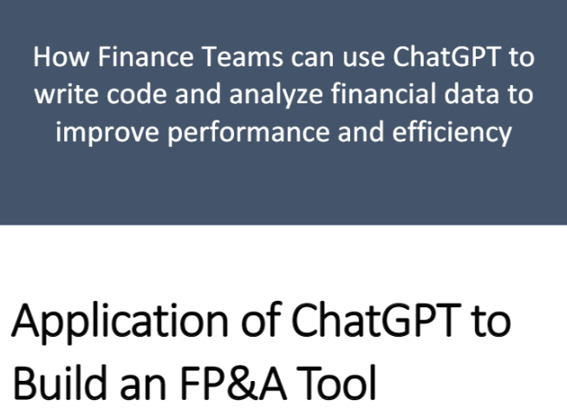
ChatGPT
LinkedIn Post
A startup CFO used ChatGPT to build an FP&A tool | Fortune
ChatGPT-Project/ChatGPT for FPA.pdf at main · ghopper3/ChatGPT-Project · GitHub

Slide 23
Conclusion
Technology is rapidly improving
Many options exist
Start by deciding what is important to you
Market consolidation is coming
FP&A tools help enable effective and efficient FP&A departments

Slide 24
Resources
4 Key Pillars of FP&A Planning Tools — The FP&A Guy (thefpandaguy.com)
How FP&A Tools Enable Business Partnering — The FP&A Guy (thefpandaguy.com)
FP&A Selection Strategy — The FP&A Guy (thefpandaguy.com)
Selecting a CPM/EPM Tool — The FP&A Guy (thefpandaguy.com)
FP&A Planning Tools Marketplace — The FP&A Guy (thefpandaguy.com)
The FP&A 3rd Generation Market Guide

Slide 25
Q&A

